Slide 1
Work Sampling
Sections:
How Work Sampling Works
Statistical Basis of Work Sampling
Application Issues in Work Sampling
Chapter 16
Work Systems and the Methods, Measurement, and Management of Work
by Mikell P. Groover, ISBN 0-13-140650-7.
©2007 Pearson Education, Inc., Upper Saddle River, NJ. All rights reserved.

Slide 2
Work Sampling Defined
Statistical technique for determining the proportions of time spent by subjects in various defined categories of activity
Large number of observations are made over an extended period of time
Statistical inferences are drawn about the proportion of time spent by subjects in various defined categories of activity
Subjects = workers, machines
Categories of activity = setting up a machine, producing parts, idle, etc.
For statistical accuracy
  Observations must be taken at random times
  Period of the study must be representative of the types of activities performed by the subjects
Work Systems and the Methods, Measurement, and Management of Work
by Mikell P. Groover, ISBN 0-13-140650-7.
©2007 Pearson Education, Inc., Upper Saddle River, NJ. All rights reserved.

Slide 3
Historical Notes
L. H. C. Tippett – introduced the technique of work sampling (1927): snap reading method
  snapshots to observe the activity (uptime vs. downtime) of the looms
R. L. Morrow- introduced the technique in US (1941): “ratio delay study”
  Delays during production
C. L. Brisley – used the term work sampling (1952)
Work Systems and the Methods, Measurement, and Management of Work
by Mikell P. Groover, ISBN 0-13-140650-7.
©2007 Pearson Education, Inc., Upper Saddle River, NJ. All rights reserved.

Slide 4
When is Work Sampling Appropriate?
Sufficient time should be available to perform the study
  Several weeks usually required for a work sampling study
Multiple subjects
  Work sampling suited to studies involving more than one subject
Long cycle times for the jobs covered by the study
Nonrepetitive work cycles
  Jobs consist of various tasks rather than a single repetitive task
Work Systems and the Methods, Measurement, and Management of Work
by Mikell P. Groover, ISBN 0-13-140650-7.
©2007 Pearson Education, Inc., Upper Saddle River, NJ. All rights reserved.

Slide 5
Example: How Work Sampling Works
A total of 500 observations taken at random times during a one-week period (40 hours) on 10 machines with results shown below.
Category No. of observations
(1) Being set up 75
(2) Running production 300
(3) Machine idle 125
500
How many hours per week did an average machine sped in each category?
Work Systems and the Methods, Measurement, and Management of Work
by Mikell P. Groover, ISBN 0-13-140650-7.
©2007 Pearson Education, Inc., Upper Saddle River, NJ. All rights reserved.

Slide 6
Example: Solution
Proportions of time determined as number of observations in each category divided by 500
Time in each category determined by multiplying proportion by total hours (40 hr)
Category Proportion Hrs per category
(1) Being set up 75/500 = 0.15 0.15 x 40 = 6
(2) Running production 300/500 = 0.60 0.60 x 40 = 24
(3) Machine idle 125/500 = 0.25 0.25 x 40 = 10
1.00 40
Work Systems and the Methods, Measurement, and Management of Work
by Mikell P. Groover, ISBN 0-13-140650-7.
©2007 Pearson Education, Inc., Upper Saddle River, NJ. All rights reserved.

Slide 7
Work Sampling Applications
Machine utilization - how much time is spent by machines in various categories of activity
  Previous example
Worker utilization - how workers spend their time
Allowances for time standards - assessment of delay components in PFD allowance factor
Average unit time - determining the average time on each work unit
Time standards - limited statistical accuracy when standards set by work sampling
Work Systems and the Methods, Measurement, and Management of Work
by Mikell P. Groover, ISBN 0-13-140650-7.
©2007 Pearson Education, Inc., Upper Saddle River, NJ. All rights reserved.

Slide 8

Statistical Basis of Work Sampling
Binomial distribution, in which parameter p = true proportion of time spent in a given category of activity
There are usually multiple activity categories, so we have p₁, p₂, . . , p_{k}, . ., p_{K} proportions for K different activity categories
The binomial distribution can be approximated by the normal distribution, where
μ = n p
σ =
Work Systems and the Methods, Measurement, and Management of Work
by Mikell P. Groover, ISBN 0-13-140650-7.
©2007 Pearson Education, Inc., Upper Saddle River, NJ. All rights reserved.

Slide 9
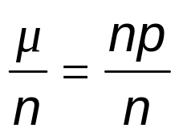
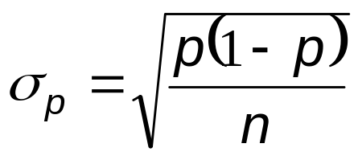
Alternative Parameters
The parameters μ and σ can be converted back to proportions by dividing by the number of observations n
p =
Work Systems and the Methods, Measurement, and Management of Work
by Mikell P. Groover, ISBN 0-13-140650-7.
©2007 Pearson Education, Inc., Upper Saddle River, NJ. All rights reserved.

Slide 10

Estimating the Proportion p
In a sampling study, we let = the proportion of the total number of observations devoted to an activity category of interest
The proportion is our estimate of the true value of the population proportion p
We would like to have a good estimation of the true value, which
  should be unbiassed
    There should be no bias (e.g., if the human subjects can anticipate when the work sampling observer were coming, they may be inclined to adjust their behaviour in response).
    To eliminate the bias by randomizing the observations
  Should have low variance
    This can be achieved by increasing the number of observations.
Work Systems and the Methods, Measurement, and Management of Work
by Mikell P. Groover, ISBN 0-13-140650-7.
©2007 Pearson Education, Inc., Upper Saddle River, NJ. All rights reserved.

Slide 11
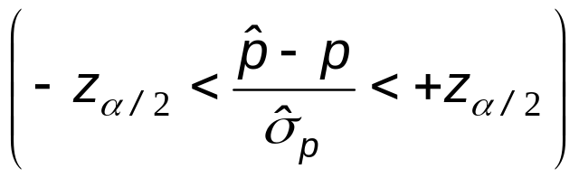
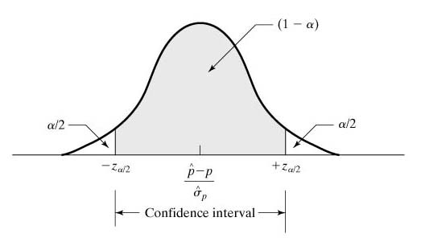
Confidence Intervals
Our aim is to estimate p within a defined error range at a confidence level
The general statement of a confidence interval for relative to p can be expressed as follows
Pr = 1 - α
Work Systems and the Methods, Measurement, and Management of Work
by Mikell P. Groover, ISBN 0-13-140650-7.
©2007 Pearson Education, Inc., Upper Saddle River, NJ. All rights reserved.

Slide 12

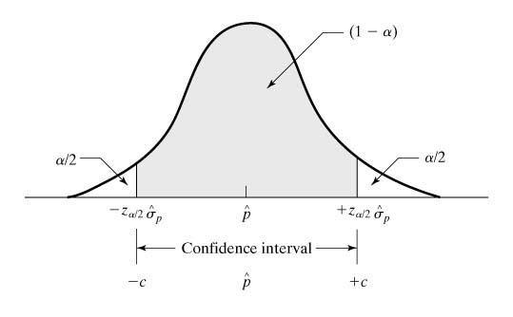
Confidence Intervals
This can be rearranged to the following
Pr = 1 - α
The probability that the actual p lies within p-z*sigma and p+z*sigma is (1-alpha)
Work Systems and the Methods, Measurement, and Management of Work
by Mikell P. Groover, ISBN 0-13-140650-7.
©2007 Pearson Education, Inc., Upper Saddle River, NJ. All rights reserved.

Slide 13
Number of Observations Required
Invreasing the number of obserations increaases the accuracy (?) and the precision (?) of our estimate.
But observations are costly. So here comes the queation:
How many observations are required to achieve a given confidence interval about the estimate of p?
We need to decide two parameters:
  Confidence level 1 - α
    This allows us to find the corresponding value of z_{α/2}
  The half-width c of the confidence interval, defined as the desired acceptable deviation from p
    Thus, we have p ± c
Work Systems and the Methods, Measurement, and Management of Work
by Mikell P. Groover, ISBN 0-13-140650-7.
©2007 Pearson Education, Inc., Upper Saddle River, NJ. All rights reserved.

Slide 14
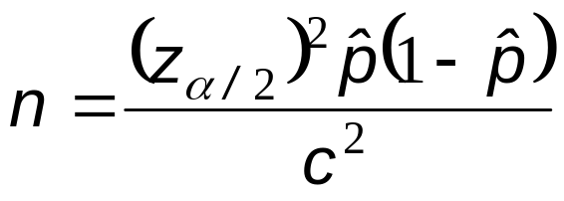
Number of Observations Required
Given z_{α/2} and c, the number of observations required to achieve the specified confidence level is given by the following
Work Systems and the Methods, Measurement, and Management of Work
by Mikell P. Groover, ISBN 0-13-140650-7.
©2007 Pearson Education, Inc., Upper Saddle River, NJ. All rights reserved.

Slide 15

Example: Determining the number of observations
Previous example. Determine how many observations will be required to estimate the proportion of time used to setup the 10 machines in the automatic lathe section. The confidence interval must be within ±0.03 of the true proportion, which the foreman initially estimates to be
=.20. A 95% confidence level will be used.
Solution:
z_{α/2}=1.96. c=.03
n=1.96²(0.2)(0.8)/0.03²=683.5
684 observations are required
Work Systems and the Methods, Measurement, and Management of Work
by Mikell P. Groover, ISBN 0-13-140650-7.
©2007 Pearson Education, Inc., Upper Saddle River, NJ. All rights reserved.

Slide 16
Use of Work Sampling to Measure Average Task and Standard Times
Work sampling can be used to determine average task times and standard times.
However, the standard times obtained by work sampling are not appropriate for wage incentive plans.
So use work sampling to measure the standard times only when other work measurement techniques become impractical
  e.g., very long cycle times, nonrepetitive tasks
Work Systems and the Methods, Measurement, and Management of Work
by Mikell P. Groover, ISBN 0-13-140650-7.
©2007 Pearson Education, Inc., Upper Saddle River, NJ. All rights reserved.

Slide 17
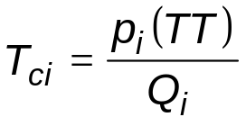
Determining Average Task Times
Average task time for a given work category is determined by computing the total time associated with the category and then dividing by the total count of work units produced by that category
where
T_{ci} = average task time,
p_{i} = proportion of observations associated with categoryi,
TT = total time, Q_{i} = total quantity associated with category i
Work Systems and the Methods, Measurement, and Management of Work
by Mikell P. Groover, ISBN 0-13-140650-7.
©2007 Pearson Education, Inc., Upper Saddle River, NJ. All rights reserved.

Slide 18
Example: Determining average task times
Consider the example in slide 5. A total of 1572 units were completed by the 10 machines and that a total of 23 setups were accomplished during the 5-day period.
Determine (a) the average task time per work unit during production (b) the average setup time.
Remember that proportion of observations associated with category “running production” was found as 0.6. For “being set up” it was 0.15.
Solution:
TT=40 hr (10 machines)=400 hr
  T_{production}=0.60(400)/1572=9.16 min
  T_{setup}=0.15(400)/23=2.609 hr
Work Systems and the Methods, Measurement, and Management of Work
by Mikell P. Groover, ISBN 0-13-140650-7.
©2007 Pearson Education, Inc., Upper Saddle River, NJ. All rights reserved.

Slide 19
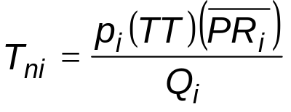
Determining Standard Times
When the purpose of the work sampling study is to set time standards, the analyst must rate the performance of the worker during each observation
First determine normal time for activity i
where
T_{ni} = normal time for work unit associated with activity i
PR_{i} = average value of the performance ratings for all observations in categoryi,
Then determine standard time
T_{stdi} = T_{ni}(1 + A_{pfd})
Work Systems and the Methods, Measurement, and Management of Work
by Mikell P. Groover, ISBN 0-13-140650-7.
©2007 Pearson Education, Inc., Upper Saddle River, NJ. All rights reserved.

Slide 20
Defining the Activity Categories
Some guidelines:
Must be defined to be consistent with objectives of study
Must be immediately recognizable by observer (mutually exclusive)
If output measures are included, then activity categories must correlate with those measures
If more than one output measure, then an activity category must be defined for each
Helpful to limit the number of categories to ten or fewer
Work Systems and the Methods, Measurement, and Management of Work
by Mikell P. Groover, ISBN 0-13-140650-7.
©2007 Pearson Education, Inc., Upper Saddle River, NJ. All rights reserved.

Slide 21
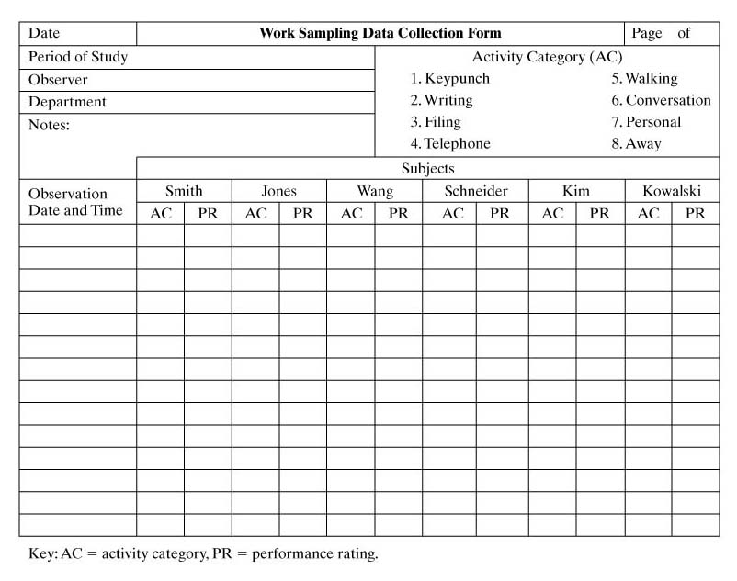
Work Sampling Observation Form
Work Systems and the Methods, Measurement, and Management of Work
by Mikell P. Groover, ISBN 0-13-140650-7.
©2007 Pearson Education, Inc., Upper Saddle River, NJ. All rights reserved.

Slide 22
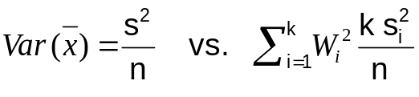
Scheduling Observations
Preparing a schedule of randomized observations
  Improve the statistical accuracy
  Reduce bias
50 round per week vs 10 rounds per day* 5 days
Sampling stratification: Total number of observations is divided into a specified number of time periods so that there are an equal number of samples taken each period
  Observation times in period are randomized
  Reduces the variance ( )
  s_{i} :sample std. dev. in period i, W_{i} : proportion of sampling in period i and s_{i} <s for all i)
Work Systems and the Methods, Measurement, and Management of Work
by Mikell P. Groover, ISBN 0-13-140650-7.
©2007 Pearson Education, Inc., Upper Saddle River, NJ. All rights reserved.

Slide 23
Example: Generation of random observation times
For the machine utilization example, generate the schedule of 10 observation times for the first day. The shift hours are 8:00 a.m. to noon, then 1:00 p.m. to 5:00 p.m.
Solution: Generate a set of three digit numbers between 1 and 999 (using a pseudo random number generators). Conversion of numbers to clock times
  Numbers with first digits=8,9,1,2,3 and 4 are read directly as the clock hour
  Numbers with first digits=0 and 6 are read as clock hours 10 and 11, respectively
  Numbers with first digits=5 and 7 are discarded
  Numbers with second digits 6 through 9 are discarded
Work Systems and the Methods, Measurement, and Management of Work
by Mikell P. Groover, ISBN 0-13-140650-7.
©2007 Pearson Education, Inc., Upper Saddle River, NJ. All rights reserved.

Slide 24
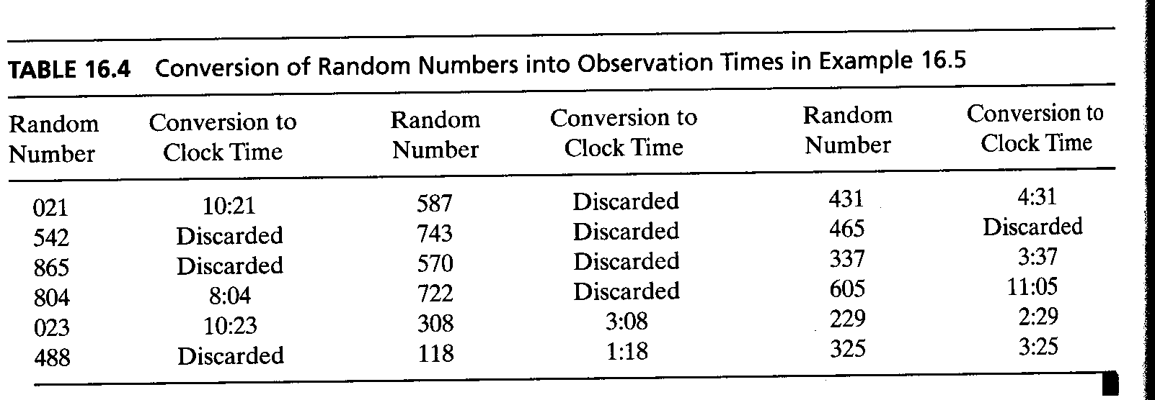
Work Systems and the Methods, Measurement, and Management of Work
by Mikell P. Groover, ISBN 0-13-140650-7.
©2007 Pearson Education, Inc., Upper Saddle River, NJ. All rights reserved.

Slide 25
Advantages of Work Sampling
Can be used to measure activities that are impractical to measure by direct observation
Multiple subjects can be included
Requires less time and lower cost than continuous direct observation
Training requirements less than DTS or PMTS
Less tiresome and tedious on observer than continuous observation
Fewer aberrations (abnormalities) than short-run observations
Being a subject in work sampling is less demanding than being watched continuously for a long time (some people are not comfartable while being watched continuously)
Work Systems and the Methods, Measurement, and Management of Work
by Mikell P. Groover, ISBN 0-13-140650-7.
©2007 Pearson Education, Inc., Upper Saddle River, NJ. All rights reserved.

Slide 26
Disadvantages and Limitations
Not as accurate for setting time standards as other work measurement techniques
Work sampling provides less detailed information about work elements than DTS or PMTS
Not proper to set standards for incentive pay systems
Usually not practical to study a single subject
Since work sampling deals with multiple subjects, individual differences will be missed
Workers may be suspicious because they do not understand the statistical basis of work sampling
Behavior of subjects may be influenced by the act of observing them
Work Systems and the Methods, Measurement, and Management of Work
by Mikell P. Groover, ISBN 0-13-140650-7.
©2007 Pearson Education, Inc., Upper Saddle River, NJ. All rights reserved.

